Slide 1
Let’s get hooked on reducing plastic waste
Utilising social media to empower change
William Rattenberry
29th May 2019

Slide 2
Let’s get hooked on reducing plastic waste
collaborate for
Utilising social media to empower change
William Rattenberry
29th May 2019

Slide 3
Declarations
I am not an ‘influencer’
When this began I had only about 50 followers
I am not a social media expert
I do not spend that much time on Twitter
I am passionate about protecting the environment

Slide 4
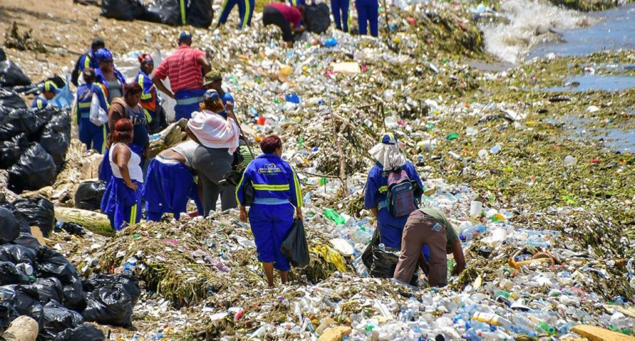
The problem
GulfCarib News

Slide 5
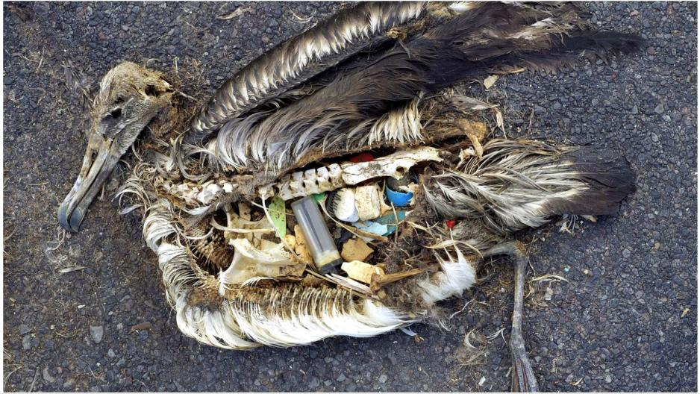
The albatross
Chris Jordan

Slide 6
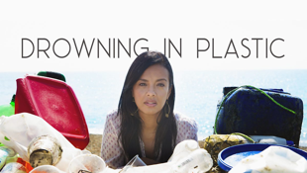
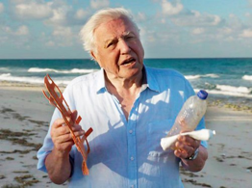
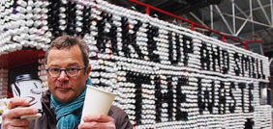
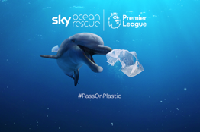
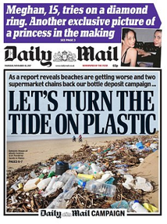
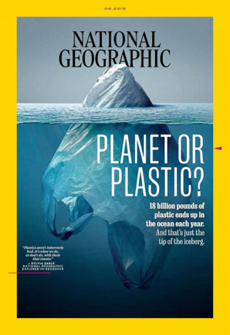
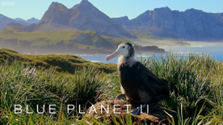
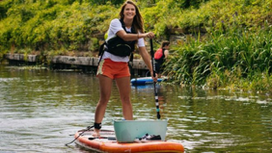
The public perception

Slide 7
Reduce, reuse, recycle

Slide 8
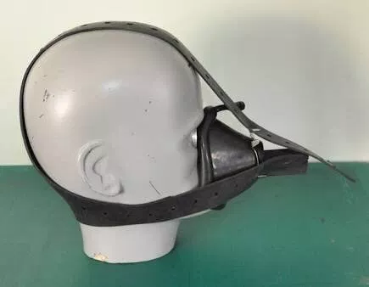
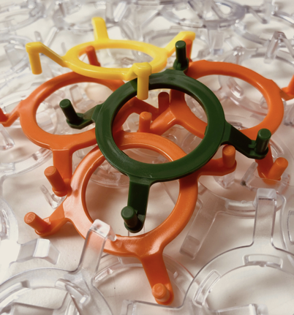
The hook ring
PatientSafe Network

Slide 9
The opportunity

Slide 10
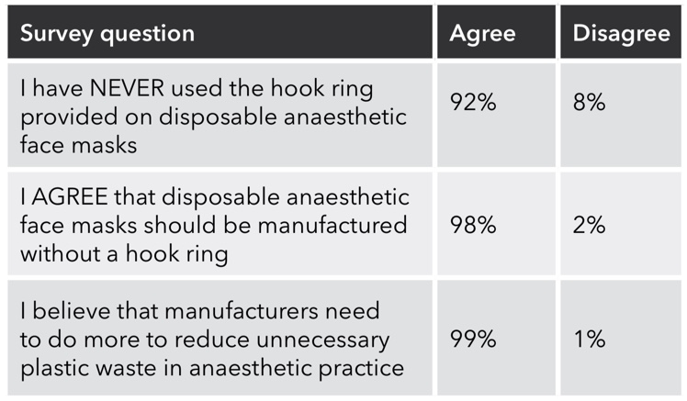
The survey

Slide 11
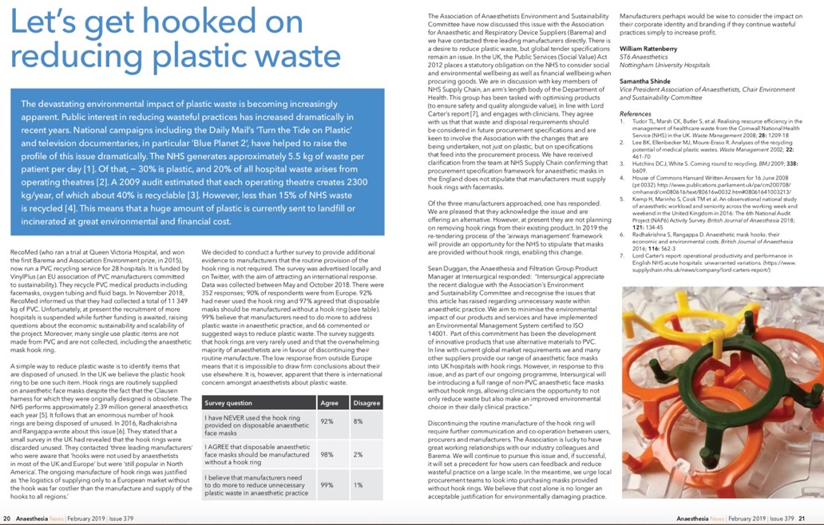
The article

Slide 12
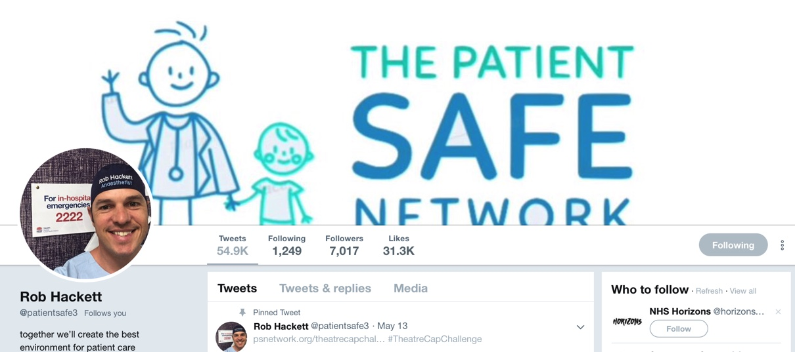
The power of social media

Slide 13
The power of social media
https://www.psnetwork.org/clausen-clip/

Slide 14
The campaign

Slide 15
The response
Following the recent social media campaign on this subject and your recent article “Lets get hooked on reducing plastic waste” published in the February edition of Anaesthesia News, Intersurgical have further extended their support of this initiative.
Whilst believing that the Non PVC ClearLite anaesthetic mask without hook ring represents the best choice for the environment, we have now committed to making both our Economy and Scented ranges of air cushion masks available without a hook ring with a target to convert the market over to these.
We hope to have the additional range in place within the coming months when the logistics and supply chain implications have been resolved.

Slide 16
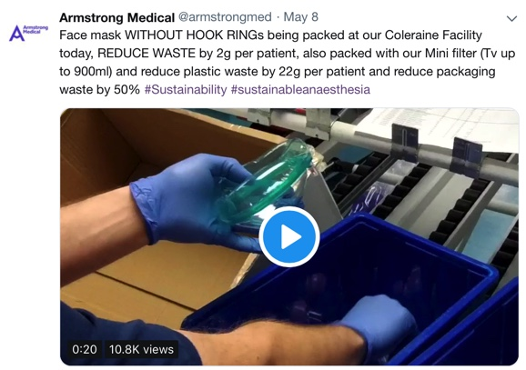
The response

Slide 17
The response

Slide 18
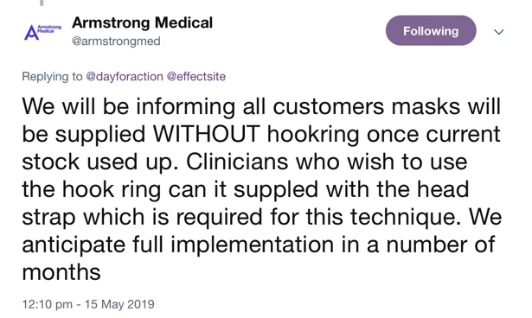
The response

Slide 19
Going forward

Slide 20
The opportunity (consumers)
Communication
Collaboration
Campaigning

Slide 21
The opportunity (industry)
Consumer feedback
Responding to concerns
Brand identity and marketing
Getting ahead of the curve

Slide 22
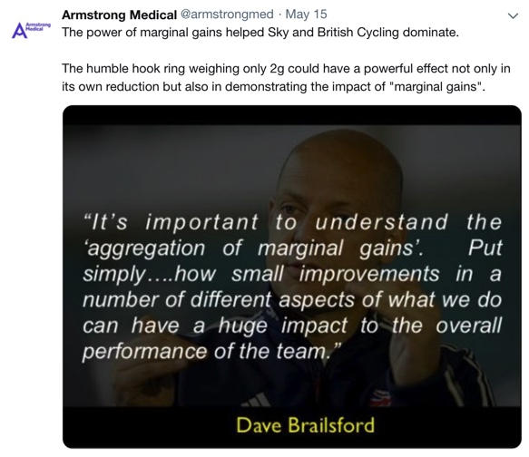
Reduce, Reuse, Recycle

Slide 23
My message
Social media can be a force for good
It can unite people around the world
You can avoid many of the negatives
Sustainability is a global problem
Social media is one part of a global solution

Slide 24
Let’s get hooked on reducing plastic waste
Utilising social media to empower change
William Rattenberry
29th May 2019

