Slide 1
Does the #TheatreCapChallenge & Scrub Standardisation have a positive effect on the theatre team and working environment ?
David Kinnersley
Matron
Cardiothoracic Department
Freeman Hospital
Newcastle Upon Tyne Hospitals
July 2018

Slide 3
#THEATRECAPCHALLENGE

Slide 4
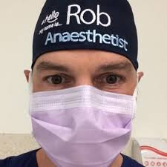
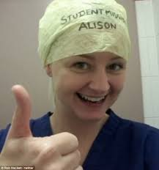
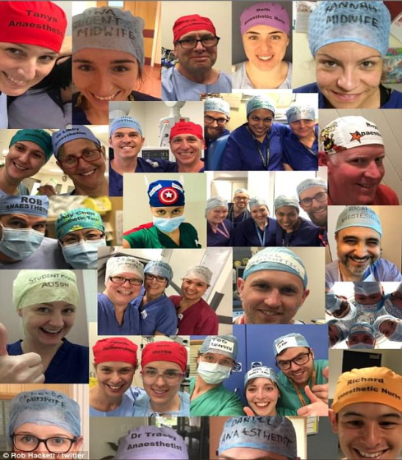
What is the #TheatreCapChallenge ?
Dr Rob Hackett was motivated to identify himself in an effort to improve patient safety, efficiency, camaraderie and collaboration in the operating theatre.
#theatrecapchallenge
Global Movement

Slide 5
Decided to Trial In Cardio Theatres

Slide 7
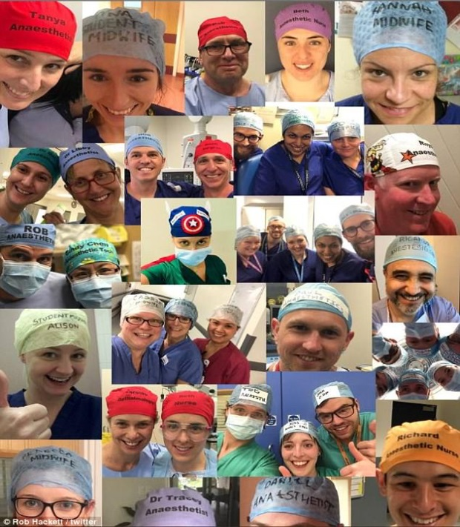
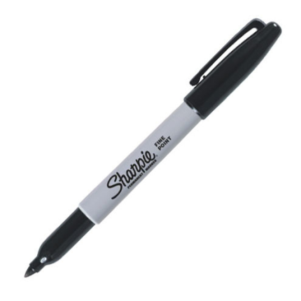
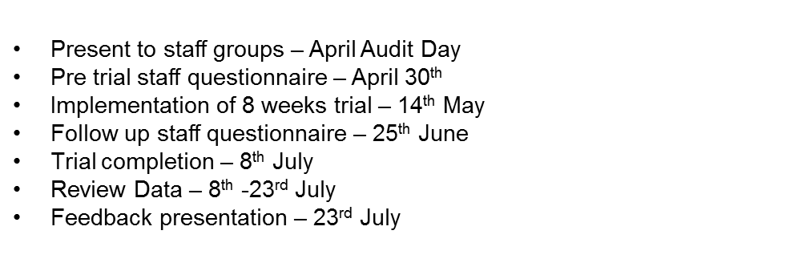
#theatrecapchallenge
The theatre cap challenge was started by Dr Rob Hackett who was motivated to identify himself in an effort to improve patient safety, efficiency, camaraderie and collaboration in the operating theatre.
The World Health Organisation Surgical Safety Checklist includes a guideline which requires all staff in operating theatres to introduce themselves prior to surgery. However this doesn’t always happen, perhaps due to lack of time or staff already being familiar with each other having previously worked together.
Even when a staff member is familiar with the names of other staff it can sometimes be hard to recognise them in full theatre scrubs when only their eyes are visible.
Morale
IPC
Key dates for Cardiotheatres trial:
Key Points:
Green Scrubs only in theatre for all staff groups
All staff to write first names & roles on theatre hats

Slide 8
Before: 73 Responses
After: 84 Responses

Slide 9
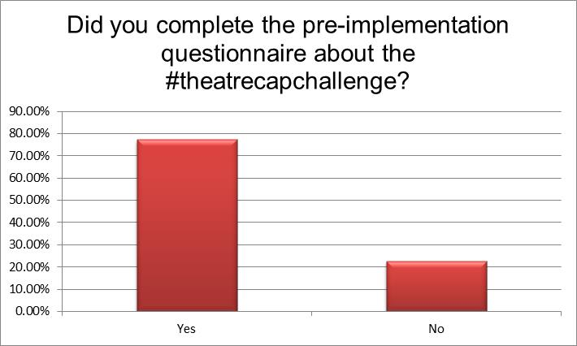
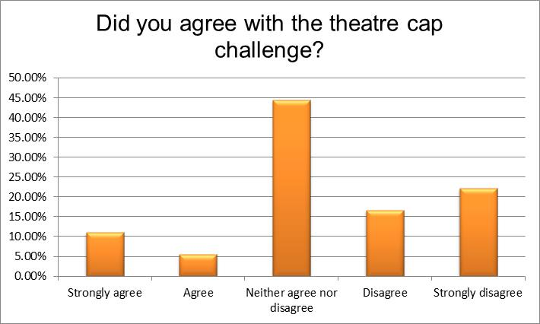
Notes:
Handle caths lab

Slide 10
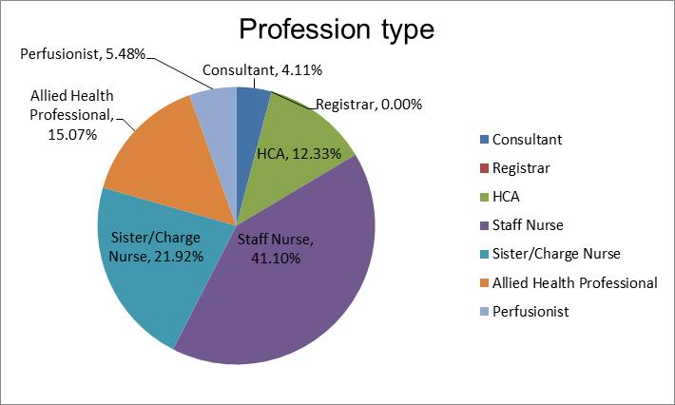
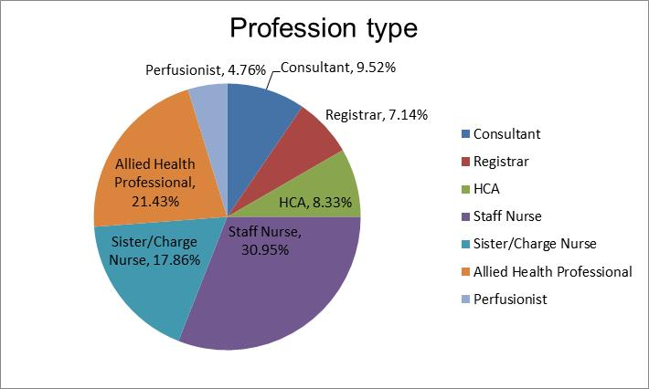
PRE
POST
Notes:
benchmark

Slide 11
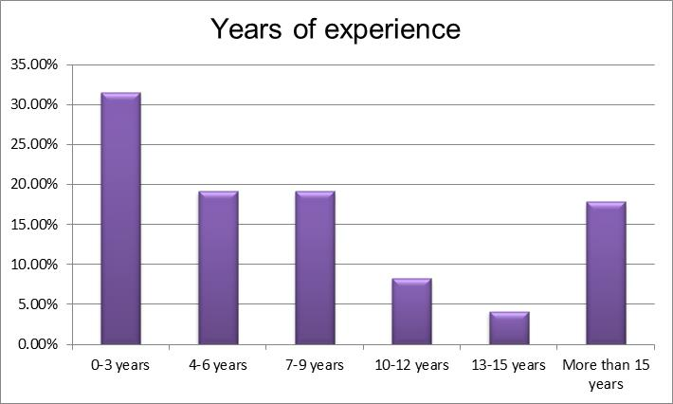
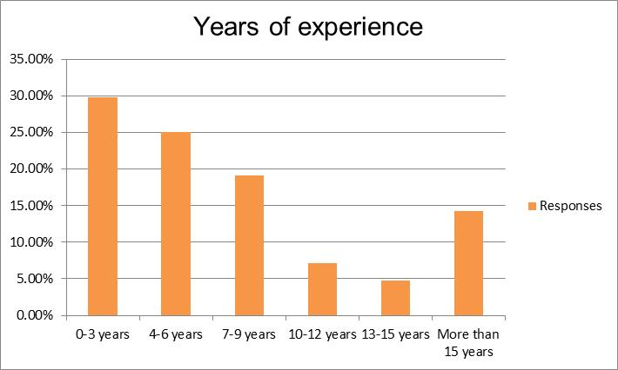
PRE
POST

Slide 12
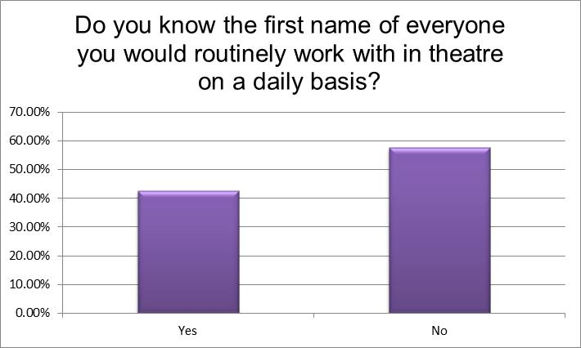
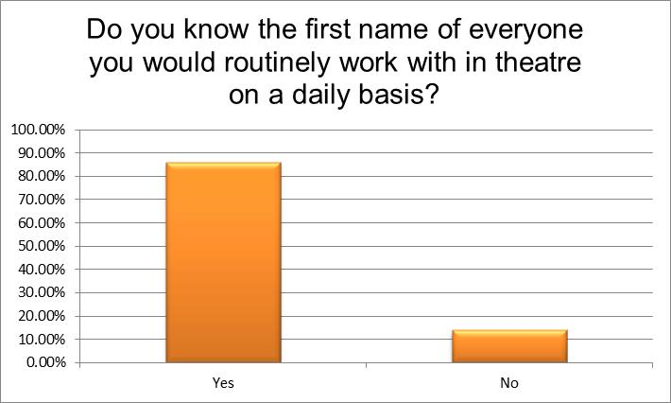
PRE
POST

Slide 13
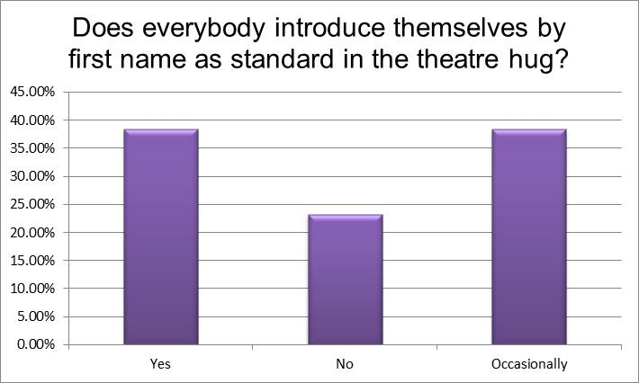
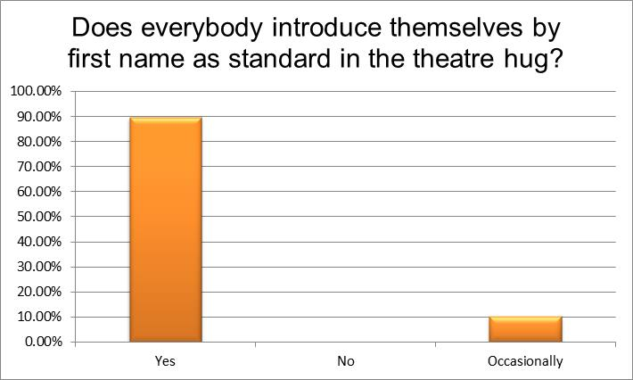
PRE
POST

Slide 14
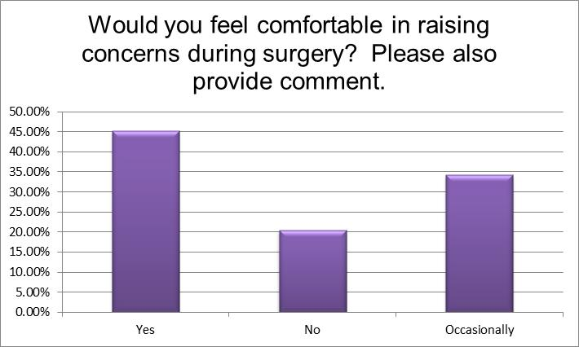
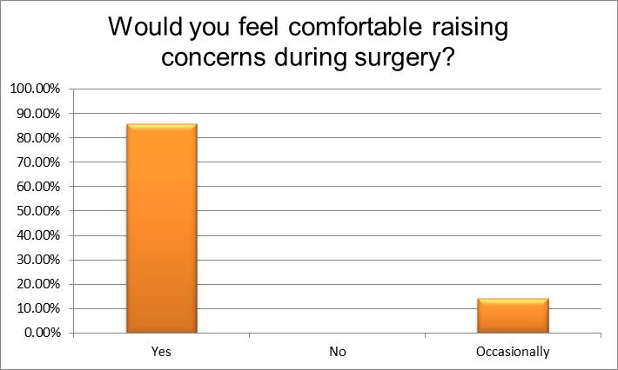
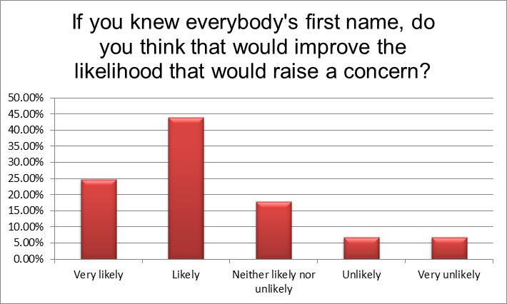
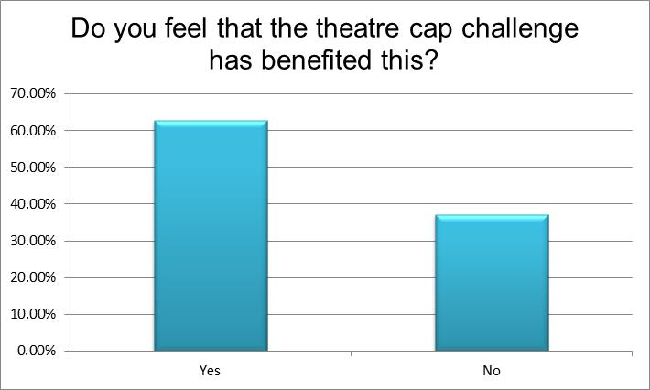
PRE
POST

Slide 15
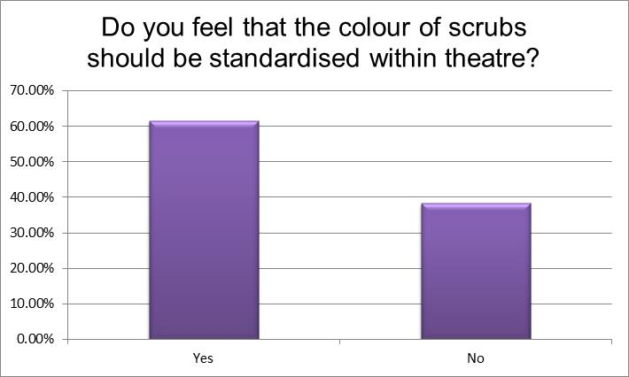
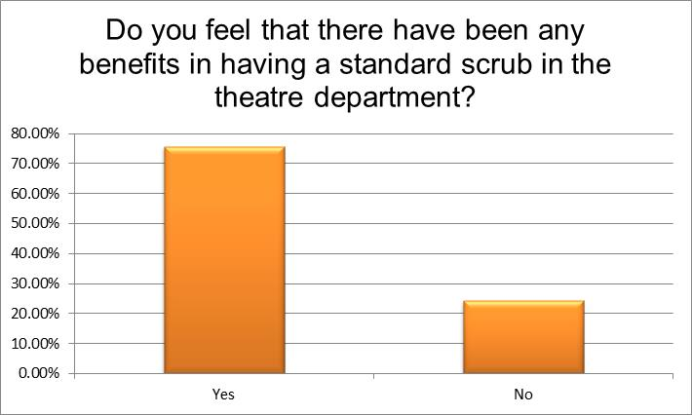
PRE
POST

Slide 16
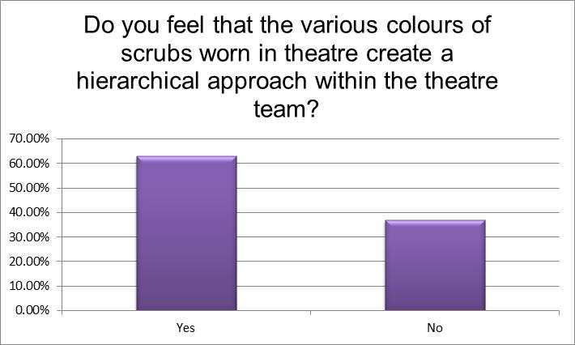
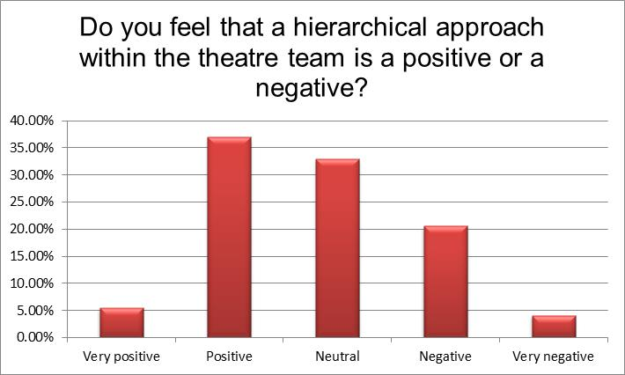
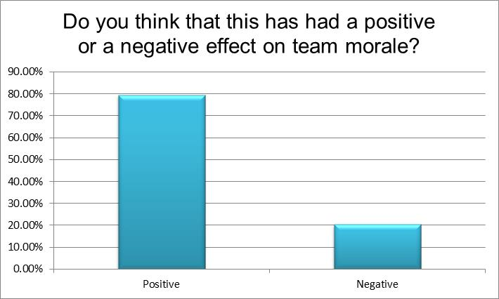
PRE
POST

Slide 17
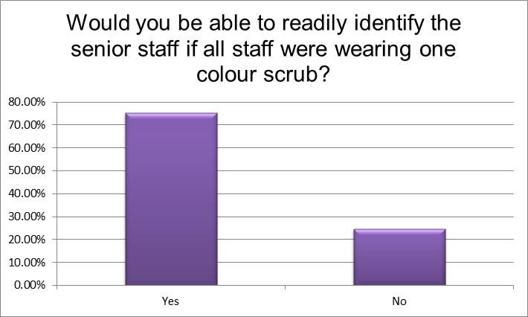
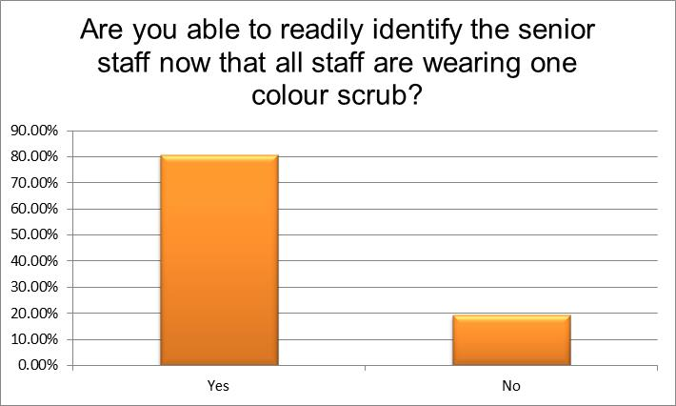
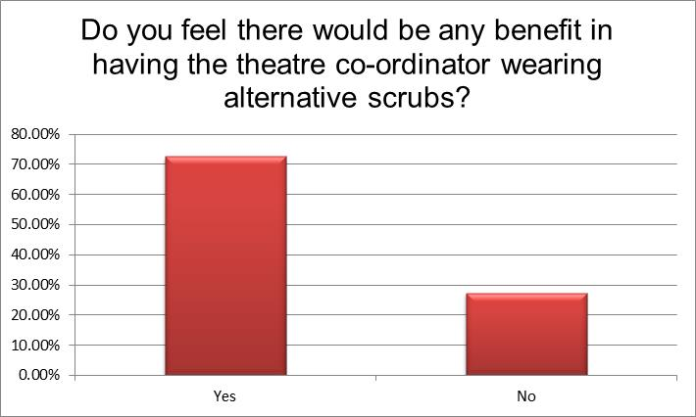
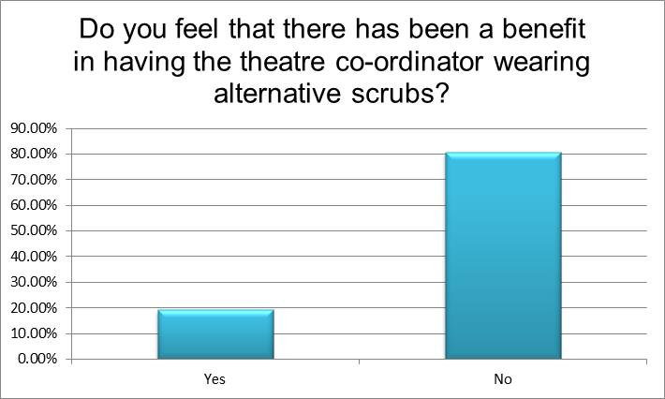
PRE
POST

Slide 18
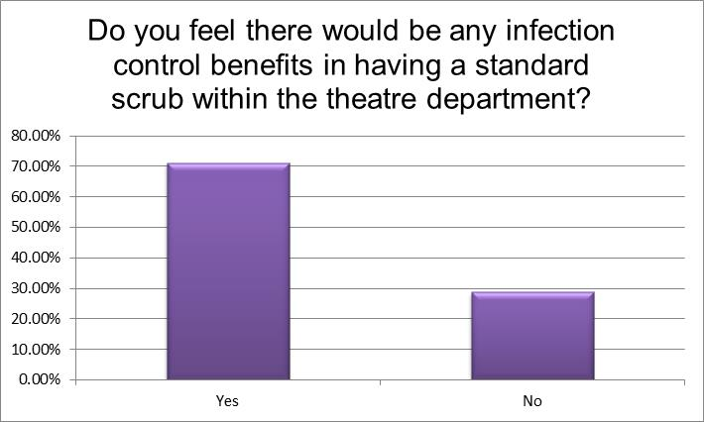
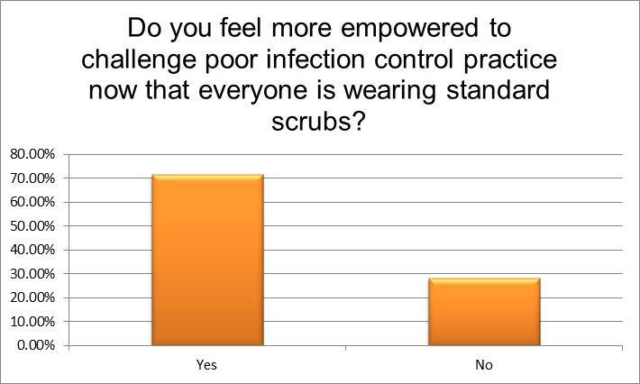
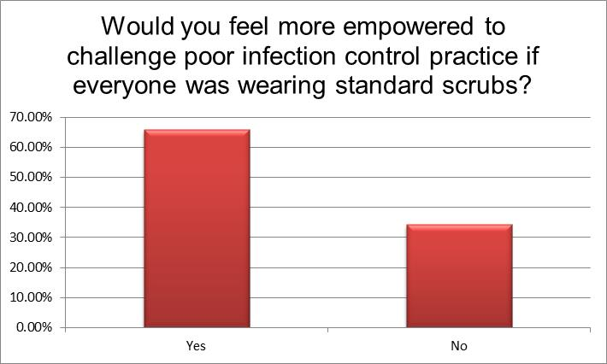
PRE
POST

Slide 19
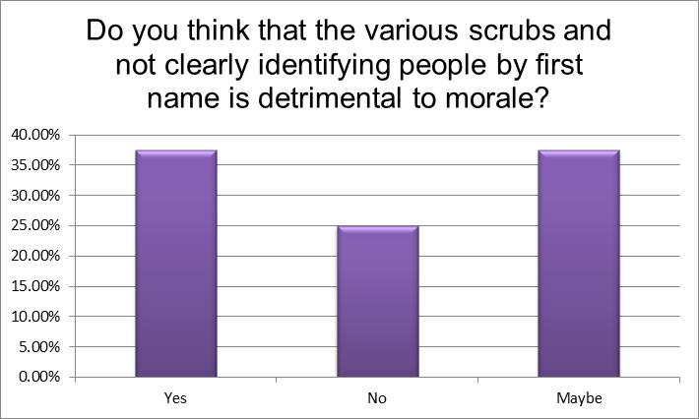
PRE

Slide 20
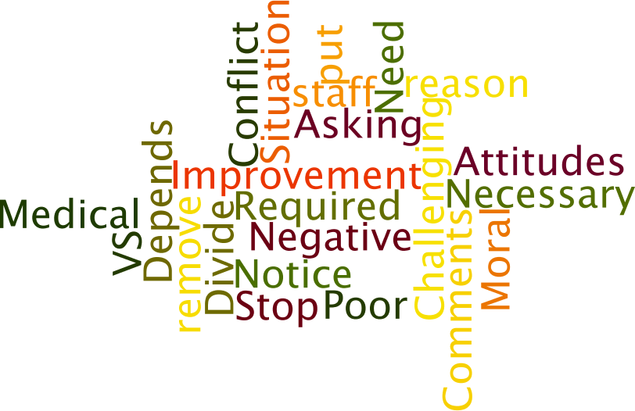
Before…..

Slide 21
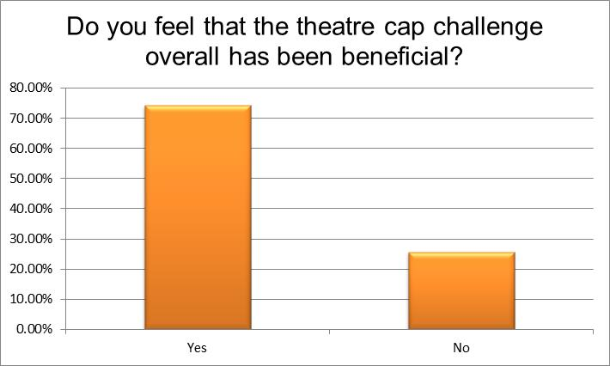
POST

Slide 22
After…..

Slide 23
Does the #TheatreCapChallenge & Scrub Standardisation have a positive effect on the theatre team and working environment ?
Embedded

Slide 24
Options Moving Forward
Keep Theatre Caps Challenge going –don’t lose momentum Or:
Explore Options re Fabric None Disposable Named Scrub Caps Or
Stop
Propose Trust Wide Trial Standardisation of Scrubs
Include Patients For Feedback
What do I recommend AND we should do:
Formally Write Up Project and Share Experience

