Slide 1
Mad as a Hatter?!
How well do we really know our theatre teams?
Zoë Burton ST7 & Matt Turner
22nd February 2018

Slide 2
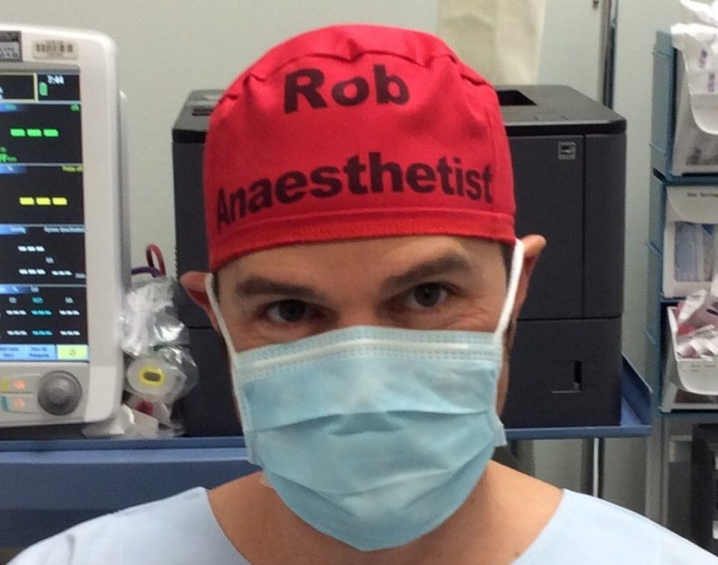
#theatrecapchallenge
Rob Hackett
Australian anaesthetist
Patient safety advocate
Series of initiatives following a death in theatres
Names/roles in crisis scenarios
Notes:
Kate Grainger #hellomynameis
We are very bad at using names in healthcare

Slide 3
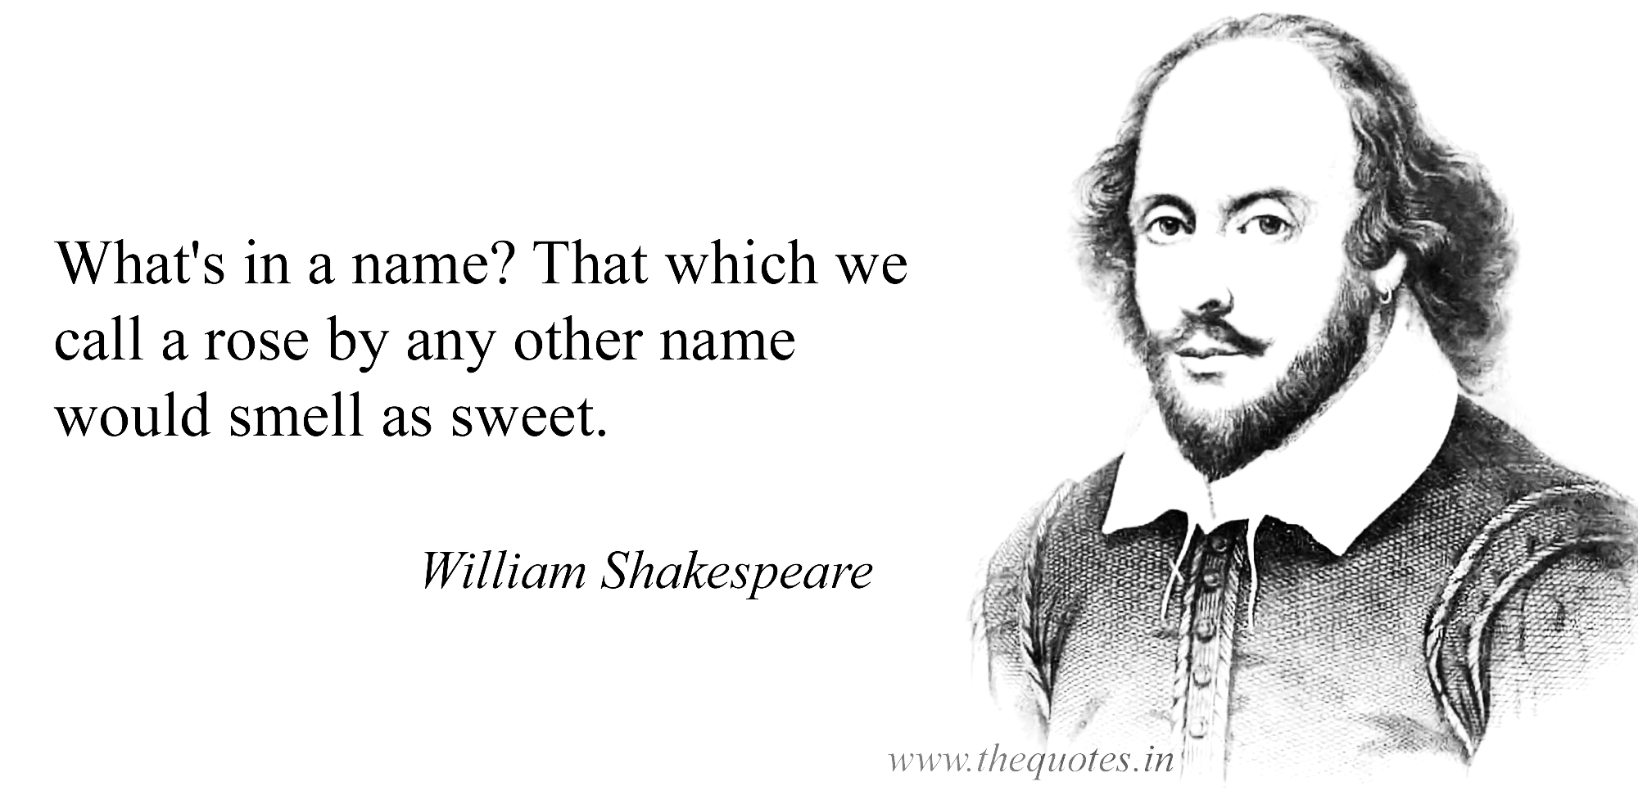
Using names = better exchange of information
Unique brain activation pattern when using names – we pay more attention
“Cocktail party effect” – tune in to the use of your own name
More effective teams when use first names → improves patient safety

Slide 4
Introductions by name and role integral part of team brief mandated by WHO checklist
Short term adult memory capacity = 4 units e.g. names¹
Personal names are particularly difficult to retrieve²
Humans only recall 30% of names after first introduction³
But surely we all know our teams in our theatres?
Notes:
Several factors related to the way information about people are structured and how words are produced conspire to make personal names particularly difficult to retrieve.
In contrast, expressions such as descriptive nicknames, kinship terms, and titles appear easier to retrieve.
“names are meaningless, arbitrary, and difficult to image”
Jobs 69%
Hobbies 68%
Home towns 62%
First names 31%
Last names 30%
Theatre team numbers often overwhelm capacity so names not recalled despite introductions

Slide 5
Methodology
Brief evaluation across D-level and E-level theatres between 10th January and 15th February 2018
Asked anaesthetists how many individuals in theatre they could name by first name
All grades
After team brief
Notes:
Orthopaedic surgeons also auditing – awaiting data

Slide 6
Results
n = 52
Total mean recall 66.6%
Better in Consultants
Name recall (%)
Notes:
Consultants doing regular lists
Trainees – spanned changeover, move lists more frequently, not in theatres as often
Most important for the CT1 just off novice period where cognitive load is high

Slide 7
Results
Theatre
Notes:
By specialty
By theatre
Theatres 8 and 9 are emergency theatres where incidents more likely to occur.

Slide 8
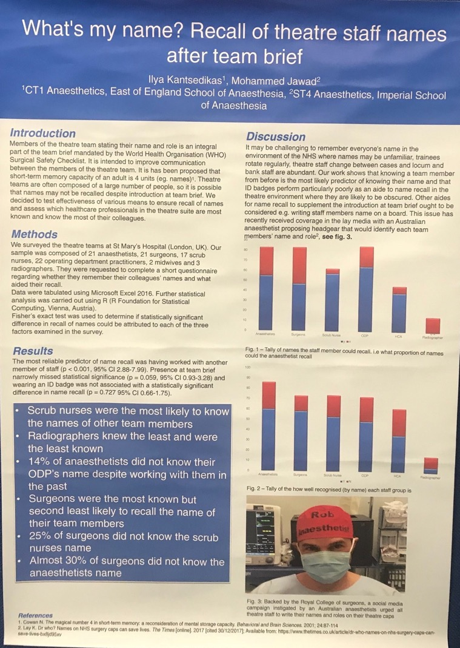
Further evidence
Study at St Mary’s Hospital⁴
Scrub nurses most likely to know team
14% anaesthetists did not know ODP
30% surgeons did not know anaesthetist
25% surgeons did not know scrub nurse
Notes:
Surgeons most known but 2nd least likely to recall names of team members
Introductions During Time-outs: Do Surgical Team Members Know One Another's Names?
Birnbach et al Jun 2017
Of the 150 OR personnel interviewed, 147 (98%) named the surgery attending correctly. The surgery attending named only 44% of other OR staff (p < 0.001). Only 62% of the OR staff correctly named the anesthesiology attending. The anesthesiology resident was the least well known but was able to name 82% of the others. The anesthesiology attending named his or her resident 100% of the time; the surgery attending correctly named his or her resident only 68% of the time (p = 0.002).

Slide 9
Further evidence
Study at St Mary’s Hospital⁴
Scrub nurses most likely to know team
14% anaesthetists did not know ODP
30% surgeons did not know anaesthetist
25% surgeons didn’t know scrub nurse
Recall NOT improved by:
Presence at team brief
Wearing ID badge

Slide 10
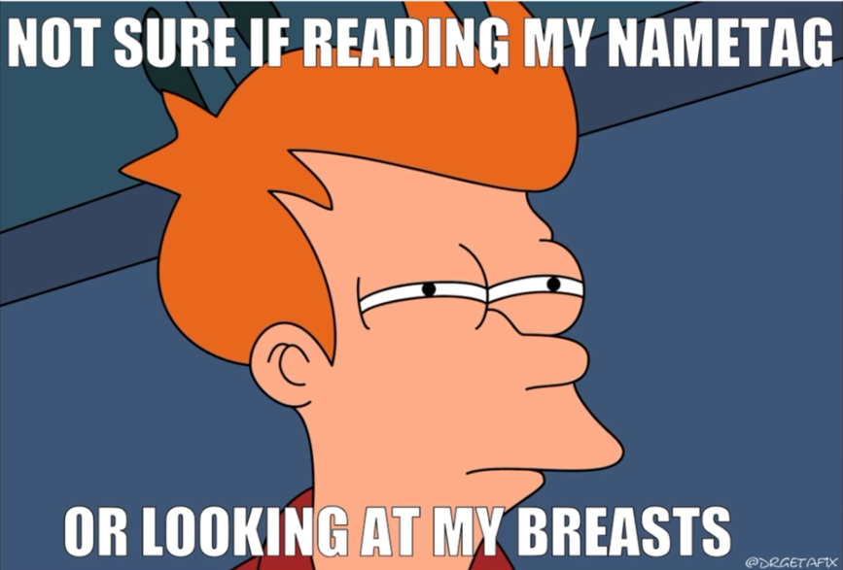
Further evidence
Study at St Mary’s Hospital⁴
Scrub nurses most likely to know team
14% anaesthetists did not know ODP
30% surgeons did not know anaesthetist
25% surgeons didn’t know scrub nurse
Recall NOT improved by:
Presence at team brief
Wearing ID badge
Recall improved if teams had worked together previously
Anecdotally, name recall better in theatres using whiteboards BUT often out of date, no good in crisis
Notes:
ID Badges often wrong way around or covered by gown

Slide 11
Softer side of science…
The bad (to ugly) | The good
Ha ha! Nice hat (smirk) | I need a hat like that – where can I get one?
Have you forgotten your name since you’ve been back? | Get called much more frequently by my name by anyone (even in corridors)
Is that so you can remember what your job is? | Presented with trauma patient notes on the ward
Why have you got your name on your hat? | Everyone should have those hats (recovery)
“Zoë Anaesthetist” – nice name | That’s a great idea - we should all have hats like that (scrub teams)
Total indifference | I wish we could have those down here (maternity)
You’re not going to get me wearing one of those | Oh, so you’re my anaesthetist (patient, halfway through pre-op)

Slide 12
Action Plan
Suggest embracing #theatrecapchallenge…
Notes:
Patient perspective important

Slide 13
Action Plan
Suggest embracing #theatrecapchallenge
Obvious, simple, effective improvement to safety
Personalised hats achieved in a number of ways
Labels/mefix/iron-on/embroidery
Maintain professionalism
Barriers to implementation
Cost
Attitudes/culture/”Semelweiss effect”
Notes:
Patient perspective important

Slide 15
References
Cowan, N. The magical number 4 in short-term memory: a reconsideration of mental storage capacity. Behav Brain Sci. 2001 Feb;24(1):87-114; discussion 114-85.
Griffin Z. Retrieving Personal Names, Referring Expressions and Terms of Address In: The Psychology of Learning and Motivation: Advances in Research and Theory. 2010; Vol 53 pp345-387
Cohen G & Faulkner D. Memory for proper names: Age differences in retrieval. 1986 June; 4(2): 187–197
Kansedikas I, Jawad M. What’s my name? Recall of theatre names after team brief. Poster submitted to AAGBI Winter Scientific Meeting, 2018
Rob Hackett @patientsafe3
#theatrecapchallenge

Slide 16
The Semmelweis reflex or "Semmelweis effect" is a metaphor for the reflex-like tendency to reject new evidence or new knowledge because it contradicts established norms, beliefs or paradigms.
Notes:
Ignaz Semelweiss – observed physicians going from cutting up dead to maternity unit where mothers all died in childbirth. Women better giving birth at home. He suggested physicians wash their hands. Physicians said “to hell with that guy” and became more obstinate about not washing hands. Semmelweiss died impoverished in a mental institution.

